Slide 1
DAF 2.0 Overview, Usage, and Examples
Thomas Satterly
10/23/2017

Slide 2
Contents
DAF Overview
Agents & Functions
Networking
Logging
DAF Usage
Constructing an Agent
Interacting with Other Agents
Building a Simulation Instance
Analyzing Results
Excel Model Builder
Example: Boid’s Birds
Observing Birds
Networking Birds

Slide 3
DAF Overview

Slide 4
Agents & Functions
Agents exhibit…
Functions exhibit…
Persistence
Event-based behavior
Interaction between agents
Basic operations
Generic execution
Single-agent interaction
Example agents
Example functions
Bird
Makes decision based on what it sees
Maintains physical state
Informs other birds of its location
Numerical Motion Integrator
EOM’s are state independent (no need for persistence)
Can be applied to any physical object

Slide 5
Basic Agent Types
Detectable
Supports RADAR and IR detection and flags for observable groups
Locatable
Statically located agent
Movable
Dynamically moving agent based on a movement type
Networked
Supports network communication
Periodic
Supports periodic execution of agent behavior

Slide 6
Networking
Networks built from switches and links
Switches
Links are defined by bandwidth and latency
Messages are published via topic groups
Messages are received by topic group subscribers
Topic groups are defined by three topic levels (Topic, sub-topic, sub-sub-topic)
Top level subscribers receive all messages regardless of sub-topic
Subscriber
Topic: Bird
Sub-topic: []
Sub-sub-topic: []
Only top-level topic defined, receives all with “Topic” = “Bird”
Publisher
Topic: Bird
Sub-topic: 10001
Sub-sub-topic: []
Subscriber
Topic: Bird
Sub-topic: 10002
Sub-sub-topic: []
Topic and Sub-topic defined, both must match to receive message

Slide 7
Logging
Logging is used to store data for post-simulation analysis
Data is logged to logging topics defined by three topic levels
Default topic used for universal log messages
Locatable types log initial position
Movable types periodically log position
Custom log topics used for more specialized post processing

Slide 8
DAF Usage

Slide 9
Constructing an Agent
Inherit from basic types to create complex agents
Most agents are combination of basic agent types
Agent-specific functionality defined at as high of a level as possible

Slide 10
Interacting with Other Agents
Networking – Two way communication
Simple networks
Star-Peer/Hub-Spoke
Parent-Child*
Observable Groups – One way observation
Agents query a database of observable agents

Slide 11
Building a Simulation
Simulations are collections of interacting agents
Agents added to simulation
Agents connected to networks and/or added to observable groups
Simulation run for period of time
Model orchestrator useful/necessary as simulations become more complex

Slide 12
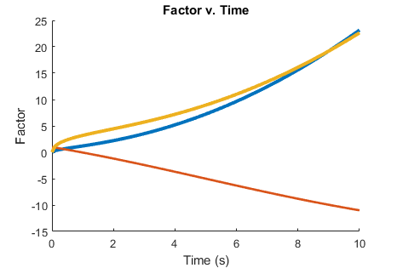
Analyzing Results
Simulation results stored in log files
Basic analyzers available through DAF
Complex analyzers constructed through the use of multiple basic analyzers
Analysis coordinator manages analyzers to minimize computation
Log Data
Coordinator
Coordinator Analyzer
Analysis
Request Analyzer
Process Data
Analyzer Pool
Provide Persistent Analyzer Object

Slide 13
Excel Model Builder
Automates and simplifies majority of building the simulation
Orchestration: Define run time, global network and observable parameters
Scenario: Define agent groups and connectivity in simulation
Available Agents: Provide base agent types and configure options
Agent Groups: Assemble available agents into groups and define relationship
Network Links: Define available networked connection types
Locations: Define universal locations
Custom orchestrators can be used with the Excel Model Builder, but are not in the scope of this presentation

Slide 14
Example: Boid’s Birds

Slide 15
Basic “Bird” Agent
Movable
publicsim.agents.base.Movable
Allows dynamic movement
Periodic
publicsim.agents.base.Periodic
Allows periodic execution
NewtonMotion
publicsim.funcs.movement
1st order motion integrator
Worldly
publicsim.agents.physical.Worldly
Defines world, eases setup
WrappingMovement
boids.funcs.movement
Lets agents move in wrapped-edge world
Bird
boids.agents.Bird
Does…
Implements periodic execution of movement
Does not…
Define how to interact with other birds
Define functions for finding new flight vector

Slide 16
Specific Bird Agents
Networked
publicsim.agents.base.Networked
Detectable
publicsim.agents.base.Detectable
Supports network communication
Flags for observable groups
Bird
boids.agents.Bird
Defines low-level bird behavior
Networked Bird
boids.agents.NetworkedBird
Observing Bird
boids.agents.ObservingBird
Defines how to interact through networking
Defines how to interact through observable groups
Common Functionality
getNewStateFromFlock
boids.funcs.flocking
Takes flock information, outputs new flight vector

Slide 17
Specific Bird Agents (Cont.)
Networked Bird
boids.agents.NetworkedBird
Defines how to interact through networking
Child
publicsim.agents.hierarchical.Child
Defines child functionality in network
Parent
publicsim.agents.hierarchical.Parent
Defines parent functionality in network
Parent Bird
boids.agents.ParentBird
Allows a networked bird to be a parent
Child Bird
boids.agents.ChildBird
Allows a networked bird to be a child
Leader Bird
boids.agents.LeaderBird
Overrides Networked Bird functionality to fly in straight line

Slide 18
Bird Analysis
Movement
publicsim.analysis.basic.Movement
Provides time history physical state
Creates or finds requested analyzer
Coordinated Analyzer
publicsim.analysis.CoordinatedAnalyzer
Coordinates access to analyzer pool
Requests movement analyzer
Bird
boids.analysis.Bird
Animates bird movement over time

Slide 19
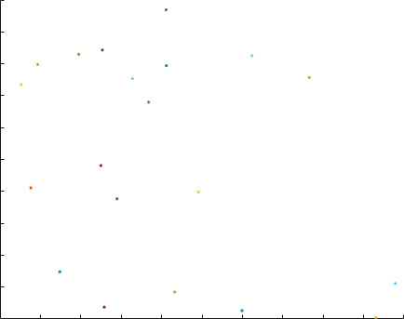
Demo: Observing Birds
Birds interact with each other through an observable group
All birds are the same type (ObservingBird)

Slide 20
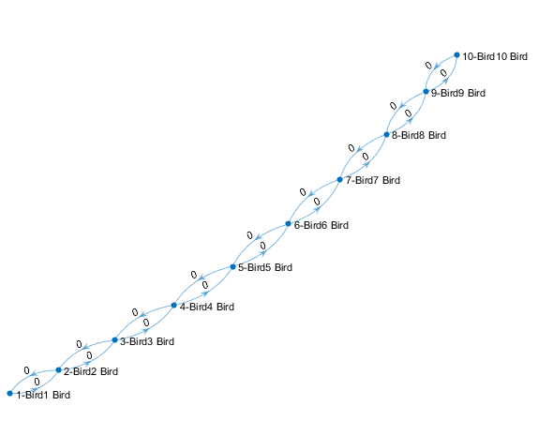
Demo: Networked Birds
Birds broadcast their position to each other through a simple network
All birds are the same type (NetworkedBird)

Slide 21
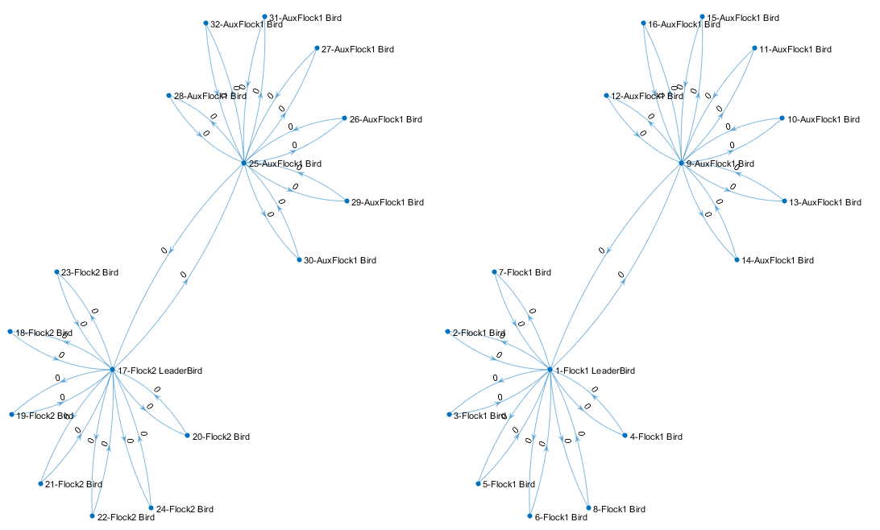
Demo: Star-Peer Networked Birds
Birds communicate to each other through two connected star-peer network
Main central bird is a LeaderBird, others are NetworkedBird

Slide 22
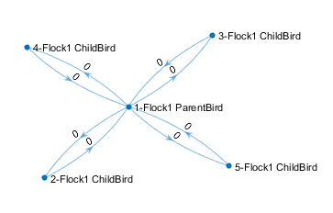
Demo: Parent-Child Networked Birds
Birds communicate to each other through parent-child networked relationship
Parent-Child has other implications
Movable types redirect physical state queries to parent
getNestedProperty used for non-default Parent properties
Result: Parent and all children move in sync

